Slide 1
Advanced methods of
molecular dynamics
Monte Carlo methods
Free energy calculations
Ab initio molecular dynamics
Quantum molecular dynamics II
Trajectory analysis

Slide 2
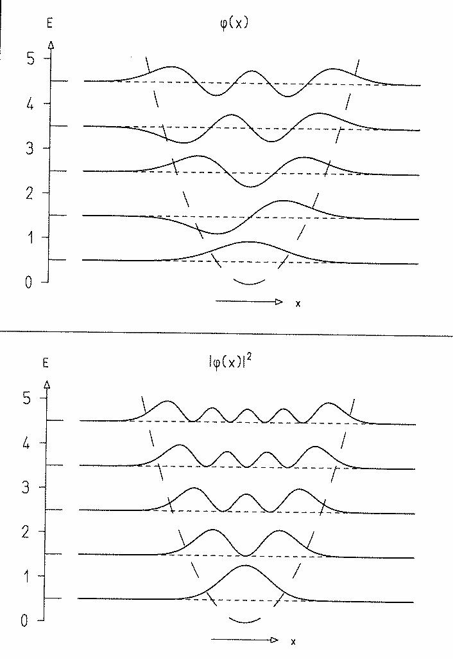
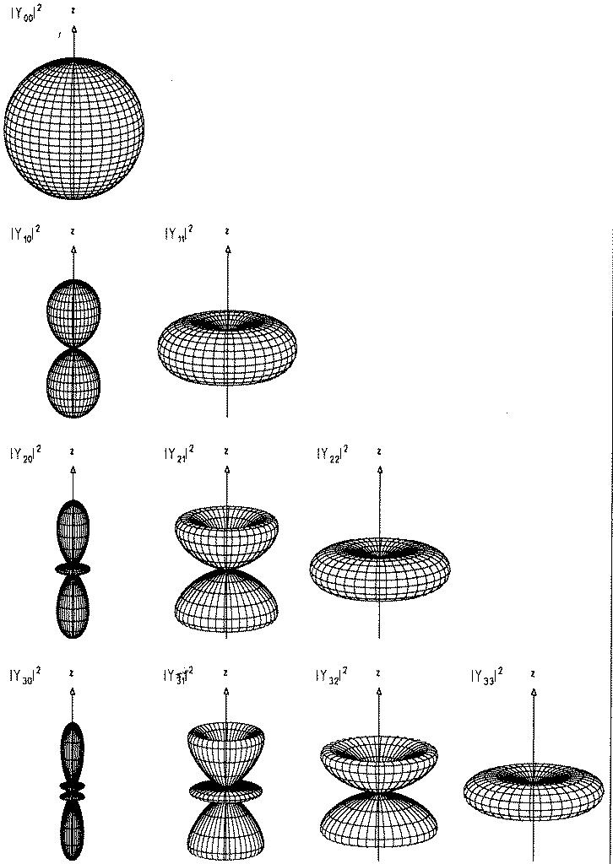
Time-dependent Schrodinger equation:
numerically exact solution
1. Discretization of the wavefunction:
- expansion into a basis (orthogonal polynomials)
- expansion on a grid (equidistant or
non-equidistant), n points, k_{max}=πh/δ
vibrations:
harmonic
oscillator
functions –
Hermite
polynomials
rotations:
free rotor
functons-
spherical
harmonics
δ

Slide 3
2. Rozvoj evolučního operátoru U:
ih∂Ψ(t)/∂t =HΨ(t) Ψ(t+Δt) = U Ψ(t) = e^{-iH Δt/ћ} Ψ(t)
i) 2nd order differences (SOD) – Taylor expansion U
U = 1 - iHΔt/ћ +... Ψ(t+Δt) = Ψ(t) - iΔt H Ψ (t)/ ћ
Numerically unstable - symmetrization (epansion +/-Δt )
Ψ(t+Δt) = Ψ(t- Δt) - 2iΔt H Ψ (t)/ ћ
conditionally stable: pro Δt<h/E_{max}
error OF the SOD method: O(Δt³)
SOD: Local (small Δ t), simple, but not very accurate
method, applicable also to time-dep. Hamiltonians.

Slide 4
ii) Split Hamiltonian method (S-O):
U ≈ e^{-iT Δt/ћ} . e^{-iV Δt/ћ} ...operators T & V non-commuting!
U ≈ e^{-iT Δt/(2h)} . e^{-iV Δt/(2ћ)} . e^{-iV Δt/(2ћ)} . e^{-iT Δt/(2ћ)} or
U ≈ e^{-iV Δt/(2h)} . e^{-iT Δt/(2ћ)} . e^{-iT Δt/(2ћ)} . e^{-iV Δt/(2ћ)} (equiv.)
Error of S-O method: O(Δt³), but smaller prefactor than SO
S-O: Local (small Δ t), more accurate than SO, applicable also to time-dependent Hamiltonians.

Slide 5
iii) Chebyshev method:
U = Σ a_{n} P_{n}(-iHt/ћ)...expansion into orthogonal polynomials
P_{n}= cos [n arccos(x)]...n^{th} Chebyshev polynomial
a_{n} = 2 J_{n}[(E_{max}-E_{min})t/(2ћ)]...Bessel functions
error of the Chebyshev method ~ e^{-N}
Chebyshev: Global (large step), accurate (exponential convergence), applicable only to time- independent Hamiltonians.
iii) Other global methods:
Lanczos method orthogonal polynomyials by repeated action od Hamiltonian on the wave function
tt’- method auxilliary time variable t’, also for H(t)

Slide 6
3. Operation of Hamilton H on wave function Ψ:
H = T + V...operators of kinetic and potential energies
In coordinate representation: Ψ= Ψ(x,t), V = V(x)
V(x)Ψ(x,t) ...local multiplication point-by-point on the grid.
T=(-iћ/2m)Δ ..nonlocal Laplace diferential operator
Δ Ψ(x_{i},t) = (Ψ(x_{i+1},t) + Ψ(x_{i-1},t) - 2 Ψ(x_{i},t))/δx²
semilocal approximation – violates uncertainity relations.
Fourier transform Ψ(x,t) Φ(k,t), multiplication by k²
inverse Fourier transform. Fast – using FFT.

Slide 7
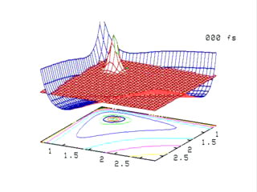
Propagation of a wavepacket in 2D
Disociation of C-H bonds in acethylene using
a train of intense ultrashort IR pulses: intenzivních ultrakrátkých infračervených pulzů:
J. T. Muckerman, Brookhaven National Laboratory

